Slide 1
September 19, 2019
Lake Tahoe Pizza Company
6pm

Slide 2
September 19, 2019 – SLTDC Agenda
Lake Tahoe Pizza Company – 6pm
1. Welcome back, Call to Order, Introductions, sign-in and quorum
2. Approval of April minutes and tonight’s agenda
3. Chair’s report:
Overview of summer activity, Sean Frame, Alpine County Meet, EDCDCC Meet
Upcoming climate strike - Sept 20- Lake view Commons 11am
Environmental activities this weekend
Results of straw polls this summer
4. Secretary update: Nancy
5 Treasurer report: Liz
6. Webmaster update: Allyson
7. Program: Chas Macquarie: Citizen Climate Lobby: Discussion of proposal for a revenue neutral carbon fee
8. New Business:
Name Cards, HS Scholarship, Volunteering at the Marathon,
Calaway canvassing – GOTV Pre-endorsement, Endorsing Candidates
Suggestions for:
Community Service: Bread and Broth 4 Kids? Warm Room?
LTCC Food Closet? Other suggestions?
Future Programs?
9 Member comments

Slide 3
Your representatives are: Susan Chandler, Allyson Tabor, Mary Lekan,
John Friedrich, Jodi Dayberry
Alternate: Nancy Gibson
There is currently one vacancy – terms end in December 2020
New Business – Sept 17th
E-mail change to edcdems@gmail.com
Rebranding of EDC Dems
Ballot for 2021-2024 – Sept 27th
20 registered democrats to get from your registered district and submit
to registrar
EDC Headquarters – Pop-up mobile centers
CAT/EDC DCC Canvassing Partnership

Slide 4
Being Elected to the EDCDCC:
The process is becoming more formal. This is an elected position if you are interested in being on the committee in 2021.
You can file after Sept 27th.
There is no cost.
If five or less people apply from BOS district 5 it will NOT be on the ballot in March.
If more than 5 people apply it will be on the ballot.
If less than 5 people apply the remaining seats can be appointed.
Please consider participating

Slide 7
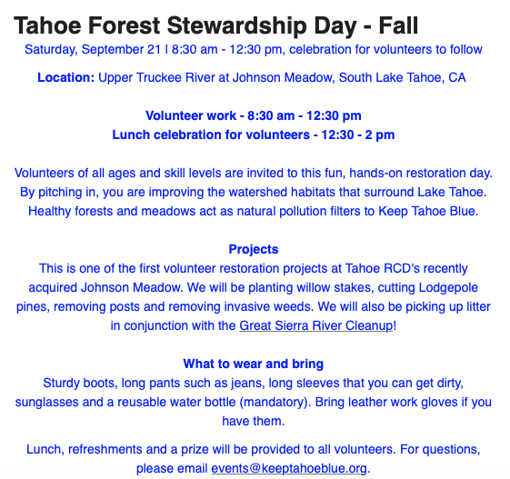

Slide 8
Membership Update:
Paid –in Members: 98
Unpaid past members: 71
Mail chimp mailing list: 349

Slide 9
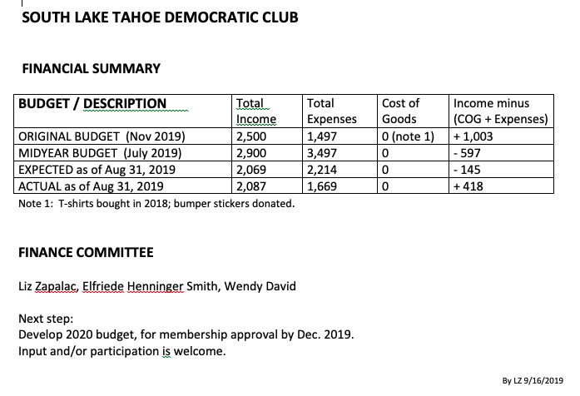

Slide 10
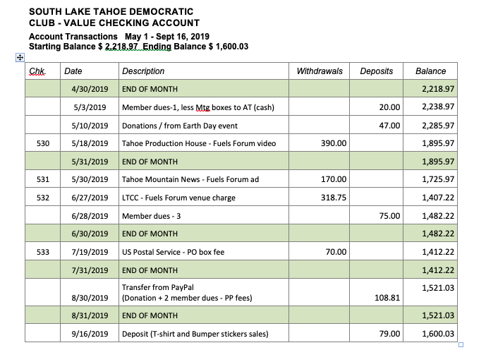

Slide 11
Chas Macquarie
Chas is a civil engineer by profession and is the former CEO of Lumos & Associates, a local civil engineering, planning, surveying, and materials testing firm. He still works part time for Lumos, focusing on bicycle and pedestrian projects. Chas is active in the Carson City community. He is a member, and past president, of the Rotary Club of Carson City. He is a founding member of Muscle Powered,
Citizens for a Walkable and Bikeable Carson City, and is the recipient of the 2014 Lifetime Achievement Award from the Nevada Bicycle and Pedestrian Advisory Board in honor of his work supporting bicyclists and pedestrians. He has been a climber and mountaineer for over half a century and his interest in the natural environment prompted him to start speaking about climate change in order to increase awareness about this very serious issue.

Slide 12
Citizen Science Celebration
Thursday, October 17 | 5:30 - 8 pm
Thursday, October 17 | 5:30 - 8 pm
Location: Himmel Haus, South Lake Tahoe, CA
Join us for a night of celebrating our dedicated volunteers and the valuable citizen
science that they do!
Food, drinks, live music, presentations and fun provided.
For questions, please email events@keeptahoeblue.org
Partners:
Desert Research Institute
Sponsors:
Himmel Haus
Soul Panda

